Slide 1
CI/HUBs PG DV
Sharing
Miles Zhu
2023.11.16

Slide 2
Agenda
PPU/PCSM
SKY1 PWR ARCH
TestFlow
Proposal & Enhance

Slide 3
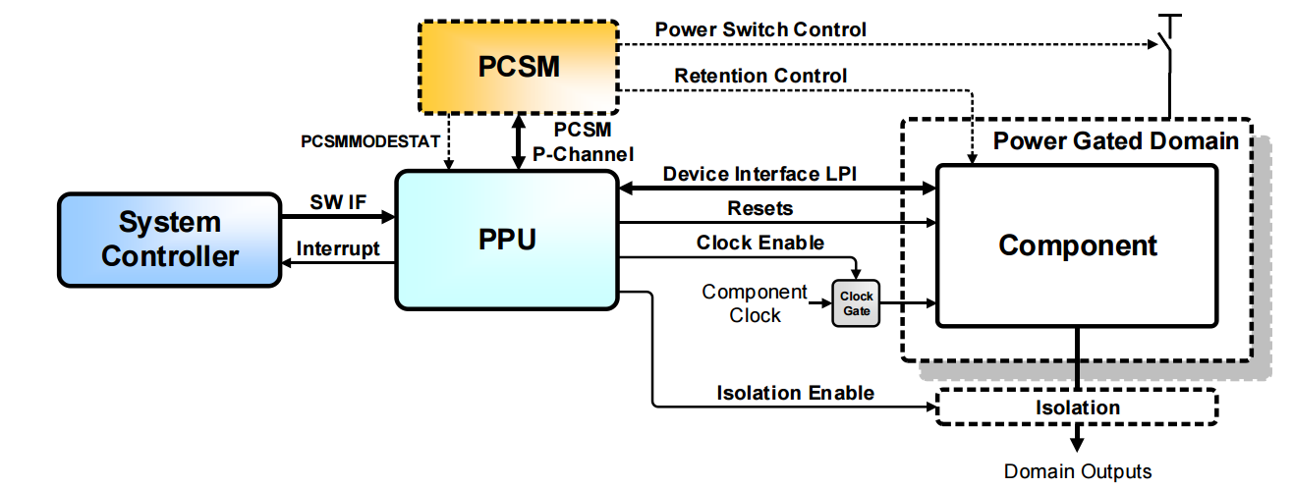
PPU/PCSM

Slide 4
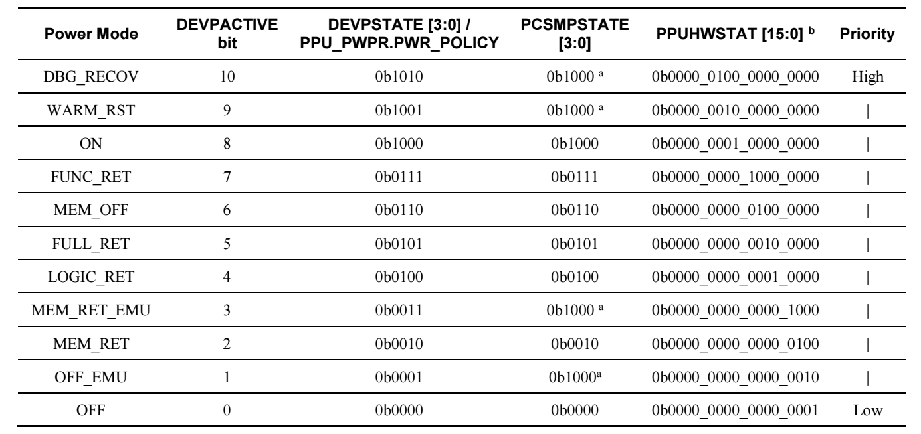
PPU/PCSM

Slide 5
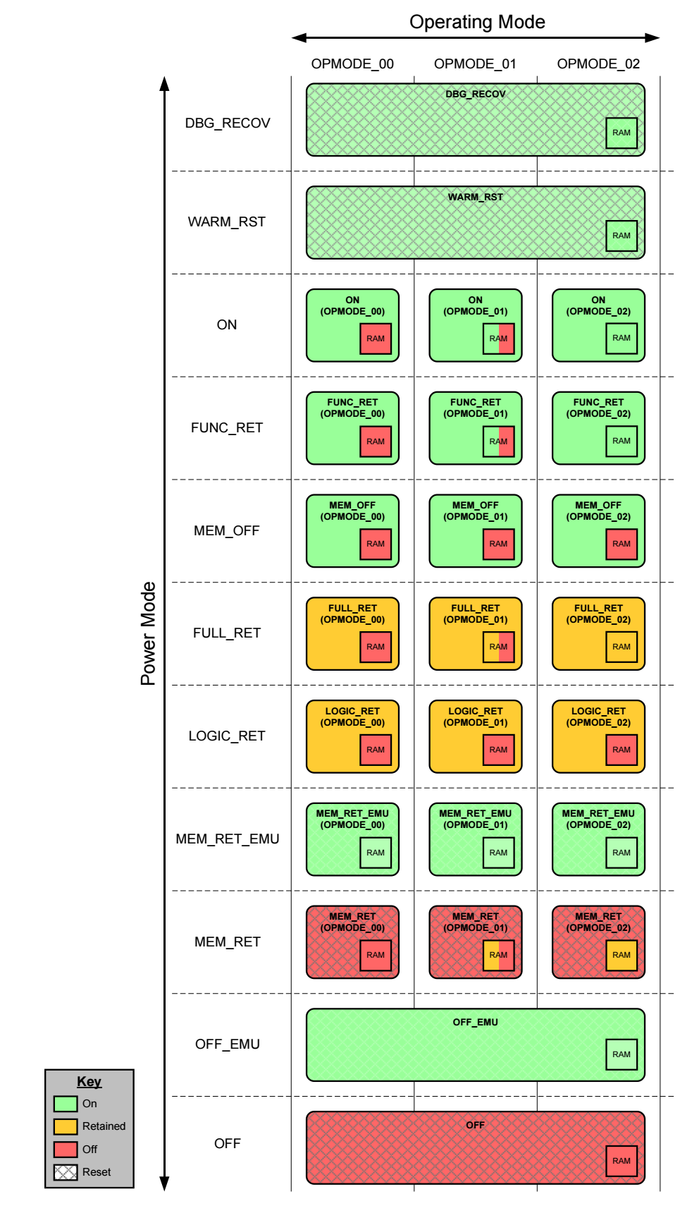
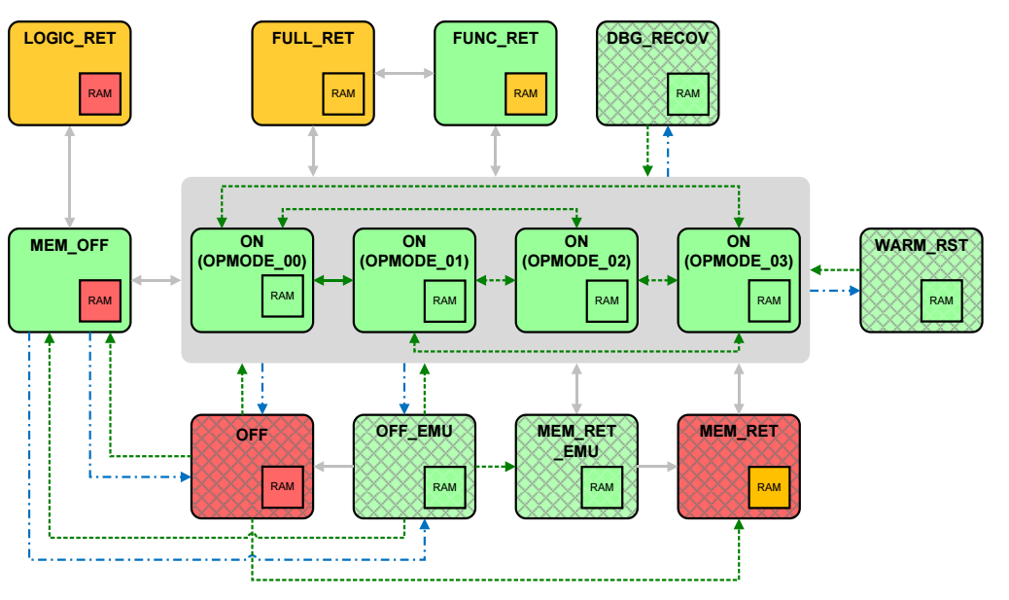
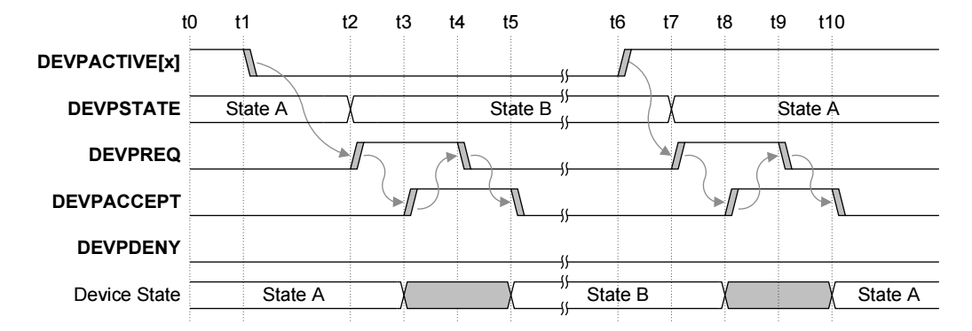
PPU/PCSM

Slide 6
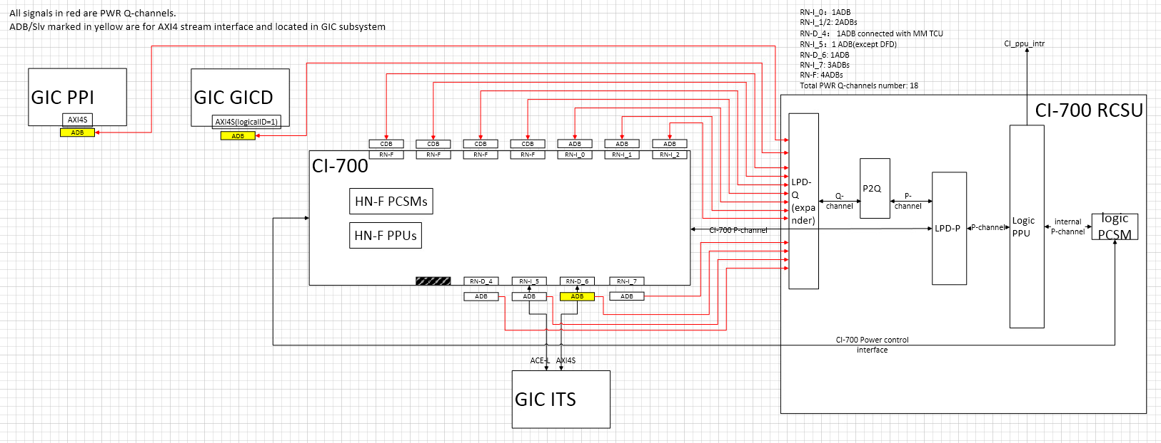
CI/NI PWR ARCH

Slide 7

Test flow
uvm
SOC_INIT
Datapath Traffic
Reuse main() and check()
Idle
PWR Switch
Pwr/OP Mode and IF check
Pwr Back
Datapath Traffic
Reuse main() and check()
Testlib should be better!
TEST FINISH

Slide 8
Proposal & Enhance
Using Testlib to generate datapath traffic
2. Package pwr seq to testlib for reuse
Xdl testcase reuse
Enhance real core cross CI pg tests

